Slide 1


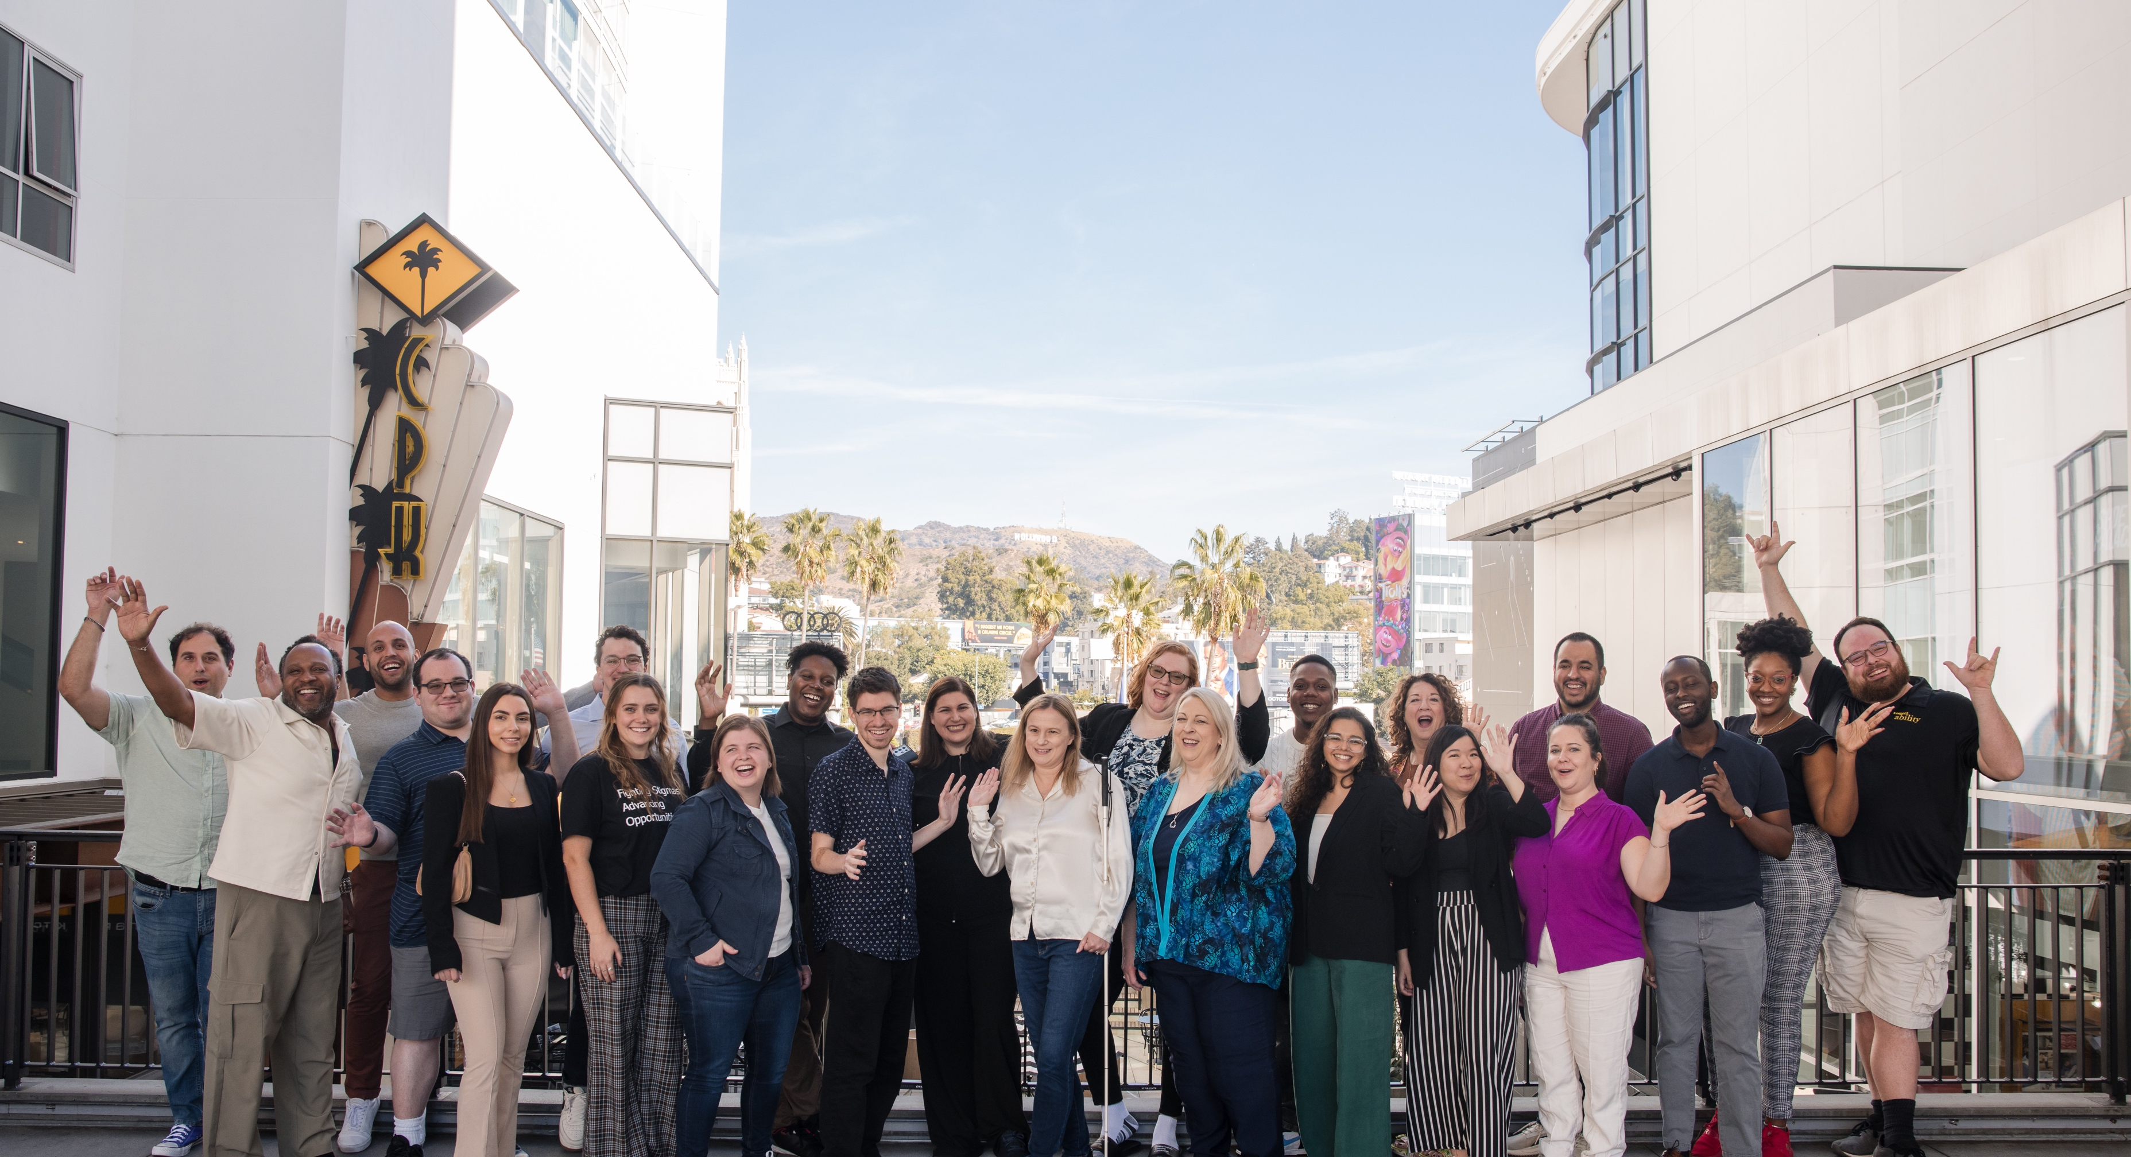
Universal Design: Enabling Good Jobs for All
Presented by:
Rebecca Langbein, Manager, National Leadership Program, Disability Belongs™
Meaghan Walls, CEO, Center for Disability Inclusion
Notes:
Rebecca kick off & welcome
Hosted by Disability Belongs (share about Disability Belongs), in partnership with CDI – turn to Meaghan to share about CDI

Slide 2
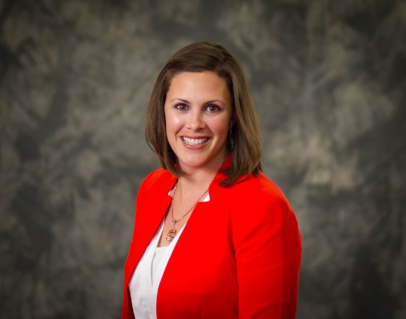
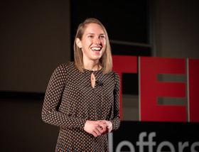
Meet Your Presenters
Meaghan Walls, CEO
Centers for Disability Inclusion
Rebecca Langbein, OTD
National Leadership Program Manager,
Disability Belongs™
Notes:
Meaghan start
Preliminary intros – name, title, visual description, where we are located

Slide 3
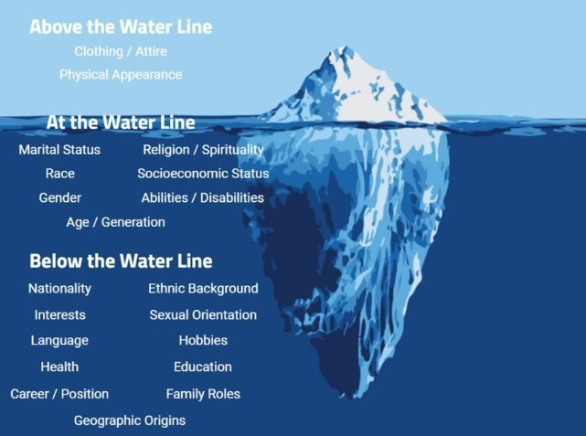
Who We Are and Who We Appear to Be
We can never know someone’s life experiences from simply how they present
The same goes for disability status – just because someone doesn’t “appear to be disabled” doesn’t mean they are not
Notes:
Below the waterline introductions
Rebecca start
Secondary description – more about us and how we came to be here and in the UD world
This is an important thing to keep in mind whenever you are thinking about the disability community, especially in the workplace. We can't know all of anyone's experiences or identities until they disclose them to us.

Slide 4
Why Does This Matter?
Notes:
Meaghan
The disability community is the largest minority group, and the only demographic group each and every one of us can join at any time in our lives. In fact, the longer we live the more likely we are to be a part of the disability community, even on a temporary basis. Thinking about how we can make the world better designed for people with disabilities will make the world better designed for all of us. And disability affects and/or will affect all of us at some point in our lives.

Slide 5
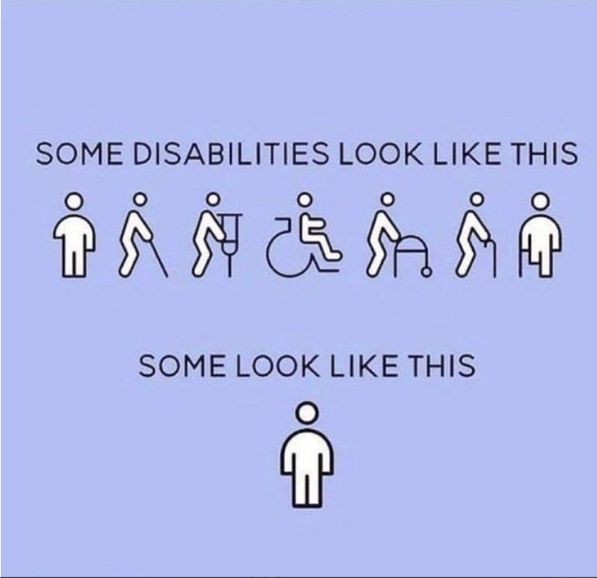
61 million people
61 million
people in the United States have a disability
1 in 4
adults have a disability
(physical, sensory, cognitive, mental health or other)
*Source: U.S. Census
Notes:
Meaghan
Impacts more people than you think. Whether yourself, someone you care about, someone you work with or all of the above.
And of all the types and categories of disability that exist, 74% of disability is considered non-apparent. That means you may never be privy to the knowledge about someone's experience with disability if they do not trust you enough to share about it.
In fact, over the last few years in our work at CDI, businesses have been telling us that Mental health self-disclosures are increasing, and are the largest category of disability disclosures they receive. This impacts accommodation policy and processes, perceptions of performance and many other aspects of workplace experiences.

Slide 6
Defining Disability
The Americans with Disabilities Act (the “ADA”) defines disability as “a physical or mental impairment that substantially limits one or more major life activities.”
Major life activities include such activities as caring for oneself, performing manual tasks, walking, seeing, hearing, speaking, breathing, learning and working.
The social model of disability looks at how people can be disabled by barriers in built environments, societies, and systems.
Notes:
Rebecca
This is not the only way to think about disability – social model
Many people think of people in wheelchairs when they think about disability but this is not the entire picture
This is something we need to keep in mind when thinking about creating an inclusive workplace

Slide 7
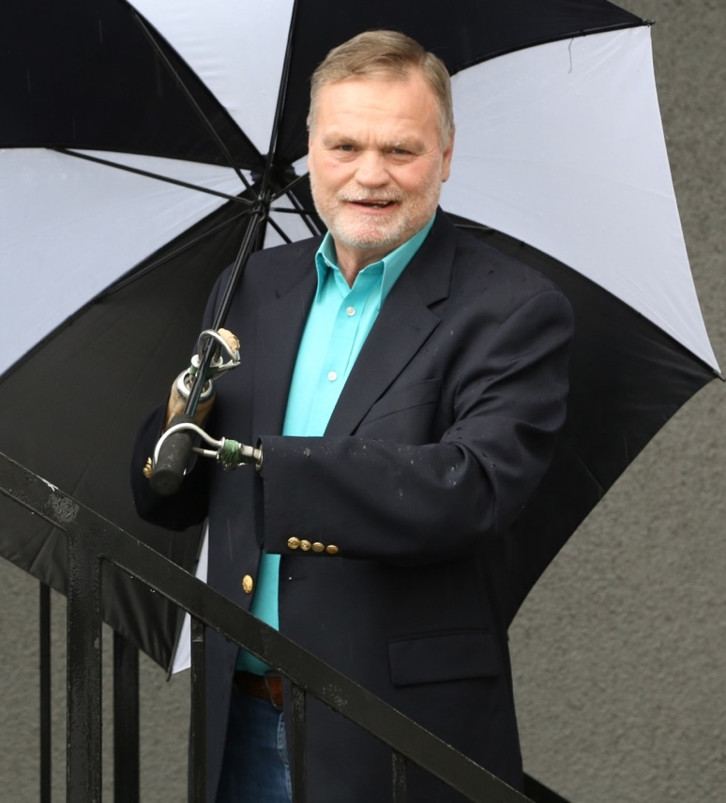
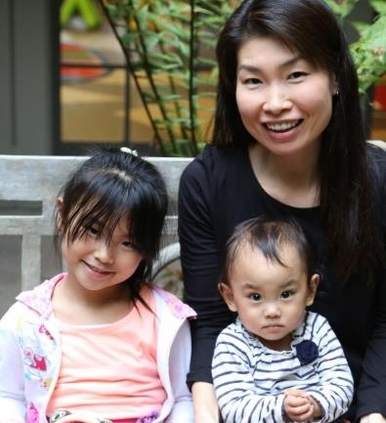
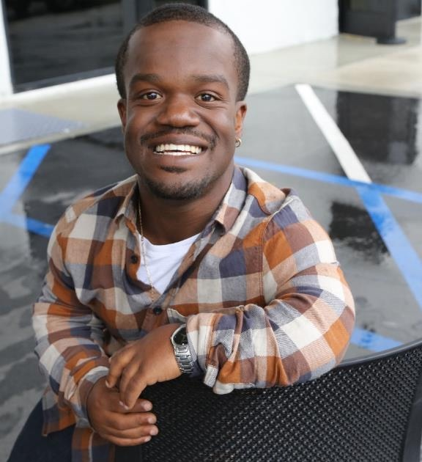
Who Does this Impact?
Disabilities are…
Temporary and Permanent
Visible and Nonvisible
From Birth or Acquired Later
Notes:
Rebecca
Only 17% of PwD are born with them; so that has a big impact on retention and the employment slide if so many people are acquiring their disabilities in life
Level set -
Because this session is not about disability awareness specifically, I am not going to go into a lot of specifics around disability, inclusive language and what not. It will certainly be infused in our time together, but not specifcially called out. So, I want to set some base line understandings for today at least.
You are already working with people with disabilities

Slide 8
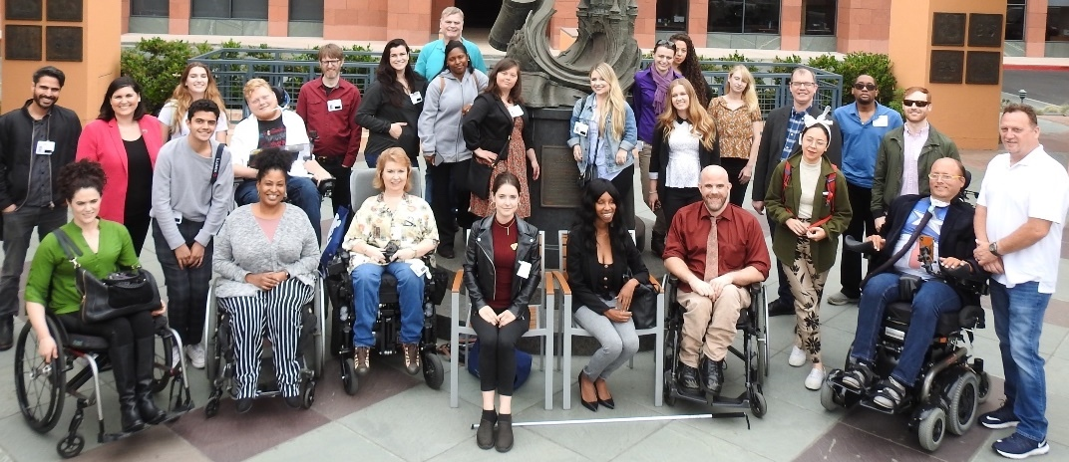
Three more facts
65%
7%
1
3
IN
of people with disabilities finish high school
of people born with a disability complete college
people with a disability have a job
What can be done to ensure success for people with disabilities?
Notes:
Rebecca

Slide 9
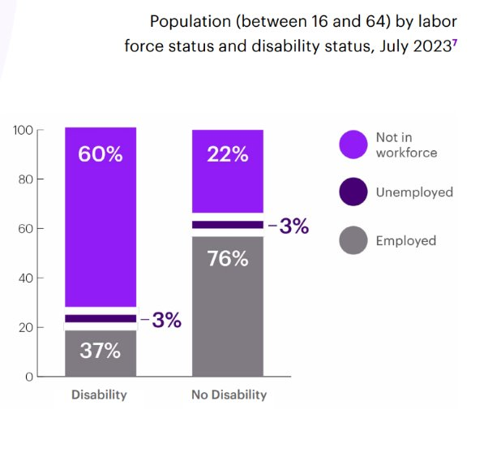
The Disability Inclusion Imperative
The disability market is valued at
more than $1 Trillion
Opening the inclusion umbrella is the right thing to do as well as economically smart given that the disability market is valued at more than $1 trillion.
Reaching the disability / chronic illness / mental health market is win-win for companies and people with disabilities alike.
Notes:
Meaghan
Accenture + Disability:IN + American Association of People with Disabilities (2018) - employment data showed huge gaps in labor force participation for PwD and non-disabled peers.
They determined that A 1% increase in employment for PwD apx 107k jobs) could mean $25 billion growth in US GDP
And also that businesses experience on average 28 percent higher revenue, double the net income and 30 percent higher economic profit margins 3 over the four-year period analyzed.
Here is a really powerful number – spending power. $1T left on the table.
But if this was easy, the gap would be closing faster. So, you have to be ready to do the work for the long haul. And it requires collaboration. In order to have a holistic impact on the business – internally and externally – requires collaboration. You need marketing, IT, HR/TA/benefits, facilities, managers and other departments willing to come together to contribute. It can't be a siloed initiative otherwise when the passionate champion of the work changes positions, roles or companies – the efforts dwindle and progress is lost.
https://www.accenture.com/content/dam/accenture/final/accenture-com/document-2/Disability-Inclusion-Report-Business-Imperative.pdf

Slide 10
Universal Design

Slide 11
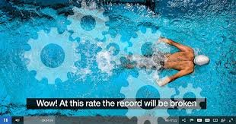
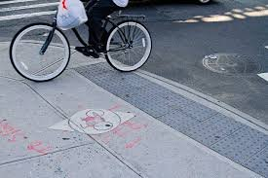
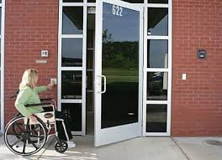
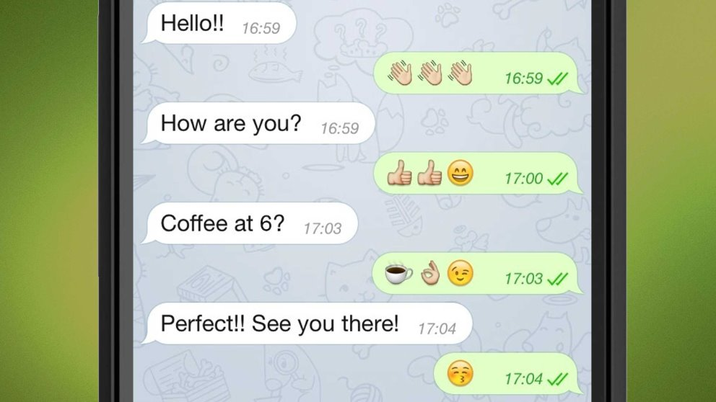
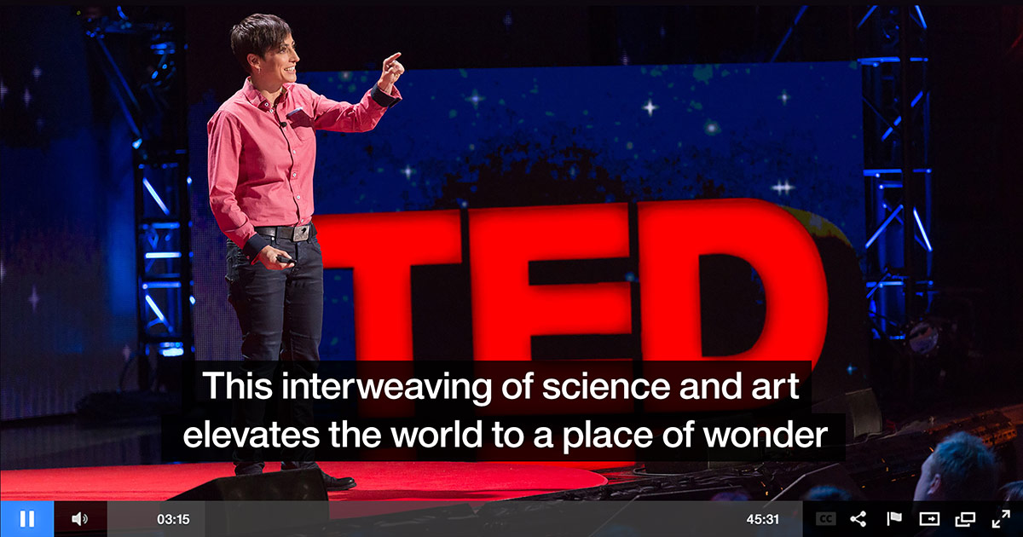
Examples of Universal Design
Notes:
Meaghan
How many of you have every used an automatic door?
Ridden your bike down the curb cuts in the sidewalk?
Watched a video with closed captioning?
We know you are sending a lot of text messages. But why did they develop?
Origin of text messages...​
Universal Design results in universal access in our everyday lives. ​
​
​
All of these are forms of assistive technology that were originally designed to help individuals with mobility or hearing impairments - but we all benefit from and enjoy using them. ​
They help create universal access to environments and information. They are part of what we call Universal Design, which means making sure it is accessible for all people regardless of age, culture, language, ability and so on. ​
​
Not everybody needs a curb cut, but everyone can use a curb cut.
​

Slide 12
What is Universal Design?
Consideration of the diverse needs and abilities of your workforce
Beneficial to workplace culture, employees, customers, workforce development
Outside the box approach
Respectful of different learning styles and preferences
A key tool for moving beyond a compliance mindset
Notes:
Rebecca
Flexible and creative
Culturally sensitive
Design that is intended to allow the largest possible group of people to participate in the activity – casting the widest net with design

Slide 13
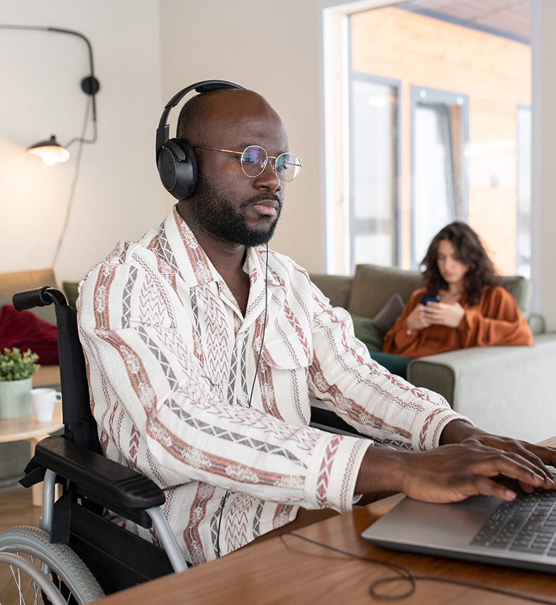
What is NOT Universal Design?
Designing for disability
A special requirement, for the benefit of only a minority of the population
Checking the boxes
Prescriptive
A magic potion
Notes:
Rebecca
The word "universal" -- casting the widest net possible
Creating policies procedures and spaces where the most people could be employed and thrive
If you have created spaces, programs and policies with this mindset from the beginning, there is not as much a need to request accommodations – allows all people to be more in successful
In an ideal world, where UD implemented well, accommodations aren't necessary
Ever-evolving
1-2 min​
What is UD and how can it help you? What it is not? - checking the boxes etc​
​
It is imperative that UD not be viewed as designing for disability - but designing for access and for the benefit of the collective community. It is good design.​
​
Define UD – in relation to compliance​
Impacts workplaces, employees and customer facing aspects of business​
​
Non-prescriptive​
Outside the box​
What do you need to do to meet the needs​
​
Best practices in policy​
Universal design​
Marketing​
Use your influence – leverage your influence to move the needle​
​
There is nothing that is truly universal – the importance of casting the widest net possible with design

Slide 14
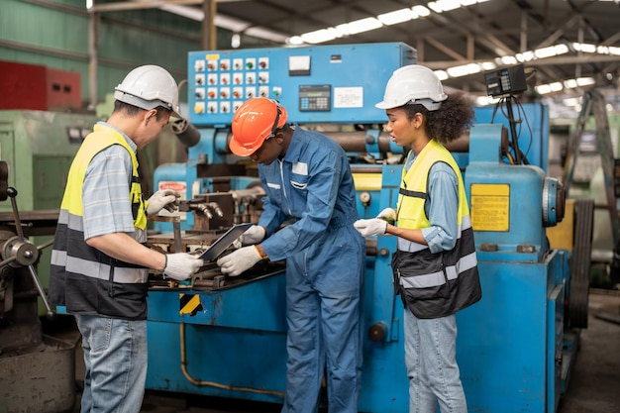
Universal Design in Practice
Implementing written instructions for how to use machinery helps people with and without disabilities do their jobs more effectively.
Notes:
Meaghan
Manufacturing story
How an accommodation can inform process change to become more universal
Outcomes – shorter onboarding, more efficiency in daily work, more successful cross training – requiring less hiring

Slide 15
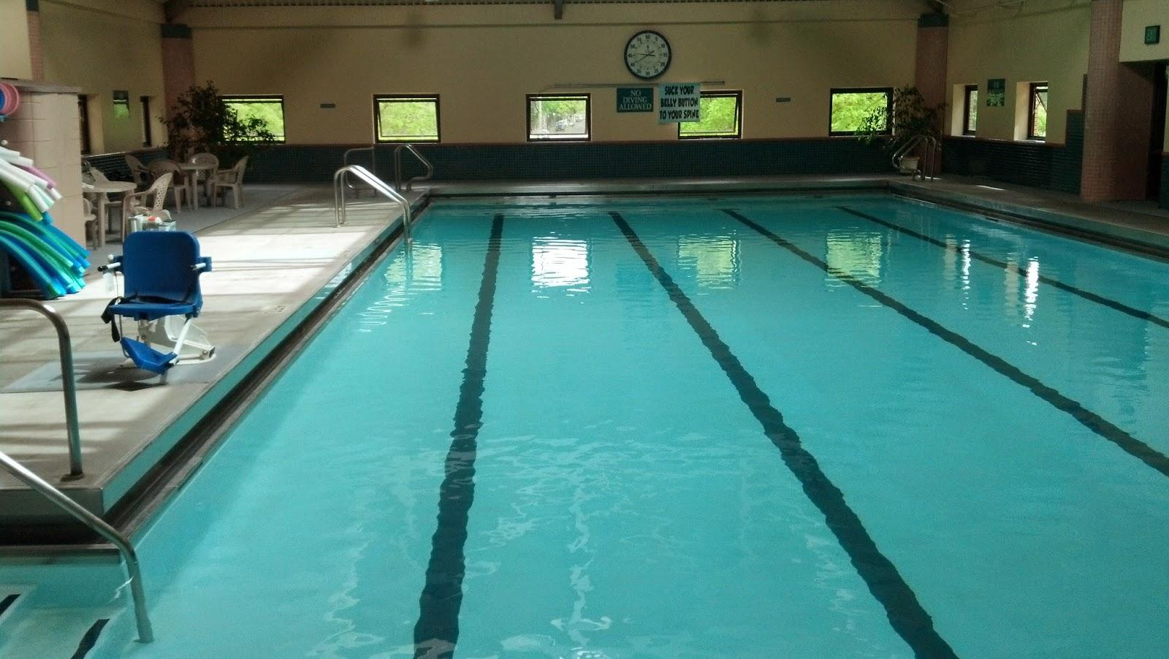
More Universal Design in Practice
Notes:
Meaghan
Best of intentions
Importance of the journey and process

Slide 16

Beyond Compliance -
Job Descriptions
Consider language use​
How accessible is the applicant tracking system?​
Are the job requirements truly essential?
Notes:
Rebecca
What processes, procedures and policies need to be in place to ensure that people with disabilities have access to good jobs?
Compliance says we cannot not hire someone because of their disability – compliance does not help us explore alternative, more accessible and inclusive means of creating job descriptions
Language used – deterring people from applying because of word choice
Platform used – Is it accessible?

Slide 17

Beyond Compliance - Interviewing
Interview format
Share questions in several formats
Allow people time to process the questions
Notes:
Rebecca
What processes, procedures and policies need to be in place to ensure that people with disabilities have access to good jobs?
Compliance says we cannot not hire someone because of their disability – compliance does not help us explore alternative, more accessible and inclusive means of interviewing
Format of interviews – skill-based or conversational?
Consider the types of environments – show people the environment they would be working in so they can anticipate what they will need to succeed and be supported
Where possible, send questions beforehand
Allowing people time to process

Slide 18
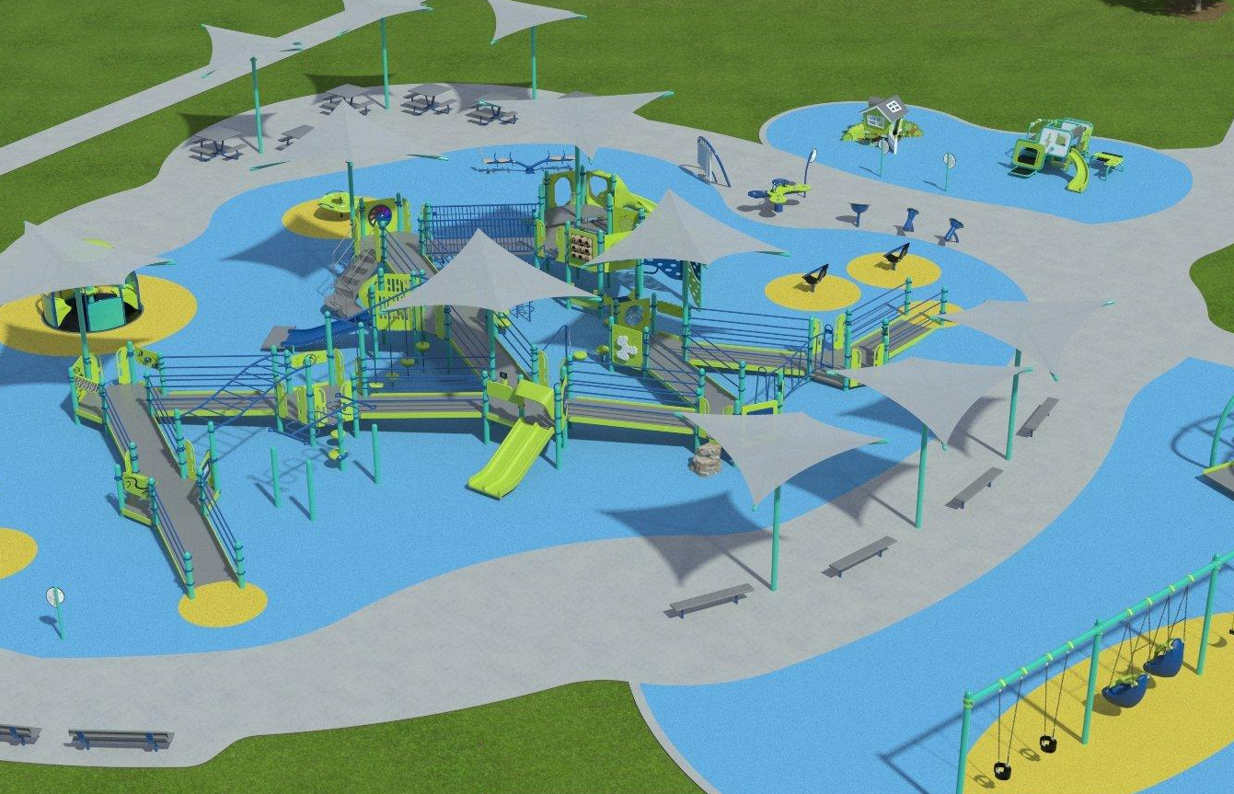
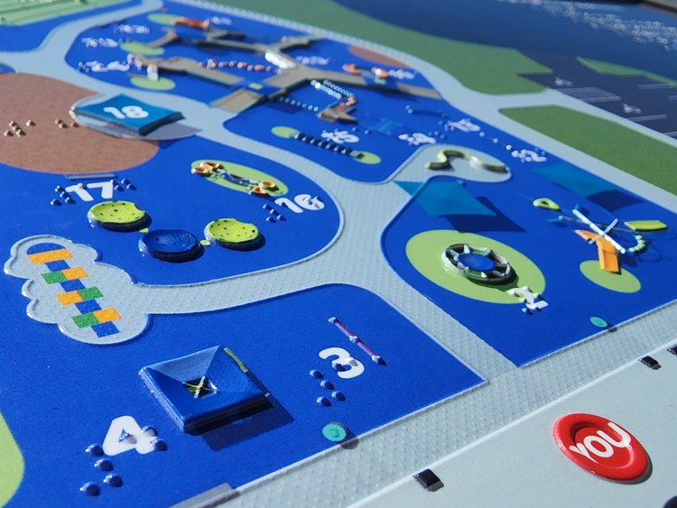
The Universal Design Process
Asking "Who does this not work for?"
Consider the full range of human experiences.
Ensuring that regardless of group composition there are opportunities for engagement, exploration, fun and safety for all.
Notes:
Meaghan
We heard a lot "oh that’s great. A playground for disabled kids" and we were like, well, yes AND their siblings, friends, classmates, grandparents, disabled parents, and friends to yet be made.
Universal Design and true access are about equitable experiences – which can mean there are options for swings, but the wheelchair accessible swing is isolated from other swings. Equitable can mean that there are tactile elements both on the ground and on the equipment, but they are different and you don't really have a choice if you cannot climb onto the equipment, and so we wanted those equitable experiences to be inclusive AND equitable.
Share about features and why they are important for full participation:
Surfacing (is an obvious one bc everyone knows that while mulch is ADA compliant, it is not actually accessible)
Color contrast
Shade
2 ramps
Socially inclusive wc swing
Toddler area – ramped house
In ground merry-go-round
Music
2 styles of seat spinners
Tactile sign

Slide 19
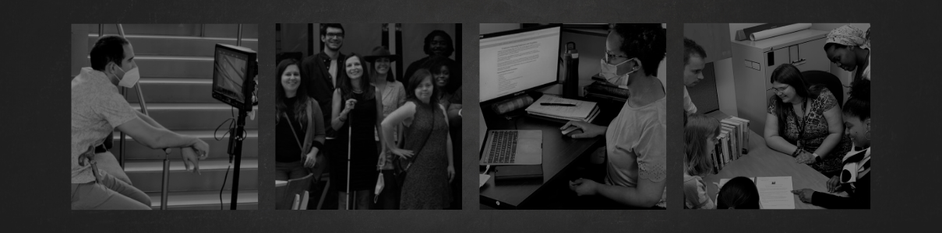
For More Information
Rebecca Langbein, Disability Belongs™, National Leadership Program Manager
Meaghan Walls, Center for Disability Inclusion, CEO mwalls@centerfordisabilityinclusion.org

