Slide 1
Ten-Fold Decrease in Job Gains for People with Disabilities
NEW POLL DATA: Voters with Disabilities and the 2020 Election
www.RespectAbility.org
March 19, 2020

Slide 2
Speakers
Steve Bartlett
Chairman, RespectAbility
He/him/his
Stan Greenberg
CEO, Greenberg Research (GQRR)
He/him/his
Jennifer Laszlo Mizrahi
President and CEO, RespectAbility
She/her/hers

Slide 3
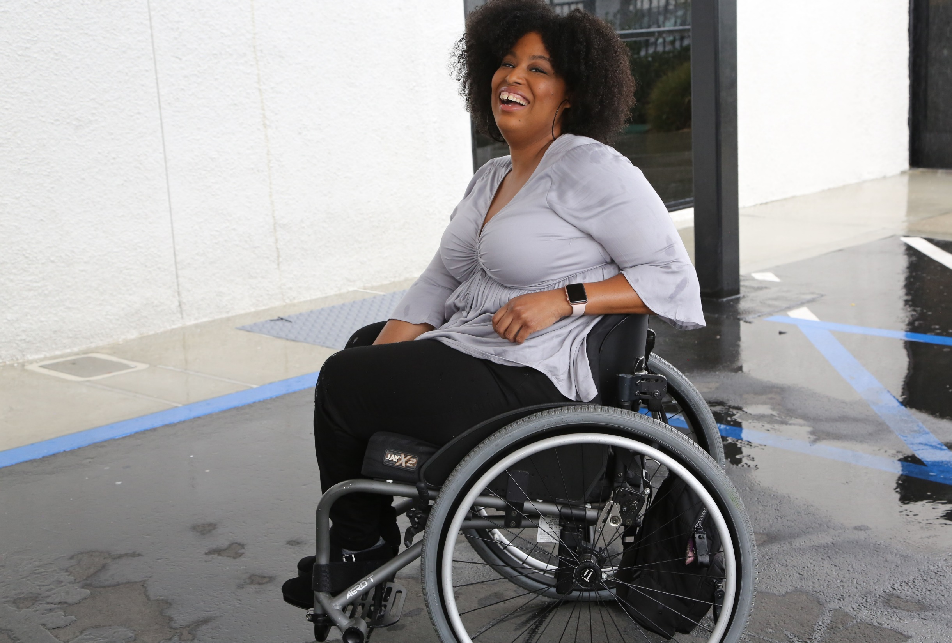
1 in 4 adults
1 in 5 people
have a disability
(physical, sensory, cognitive, mental health or other)

Slide 4
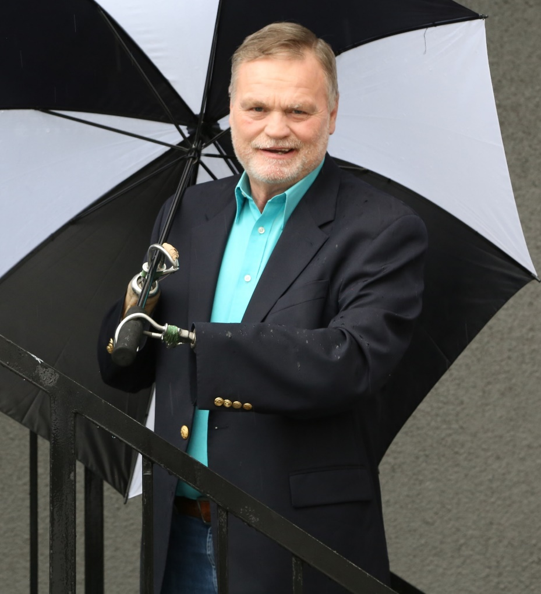
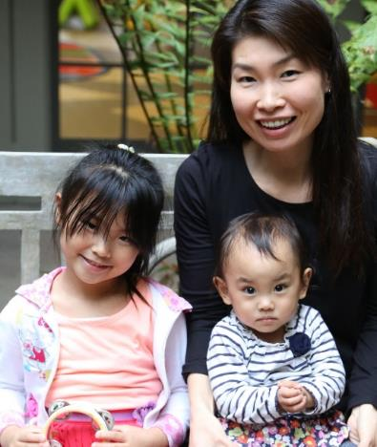
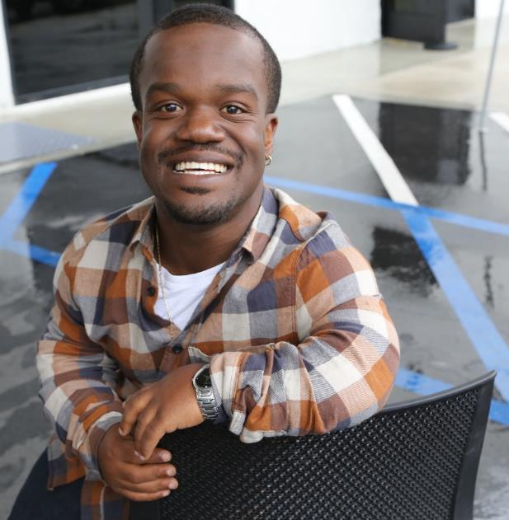
Disabilities Are….
Temporary and Permanent
Visible and Nonvisible
From Birth or Acquired Later

Slide 5
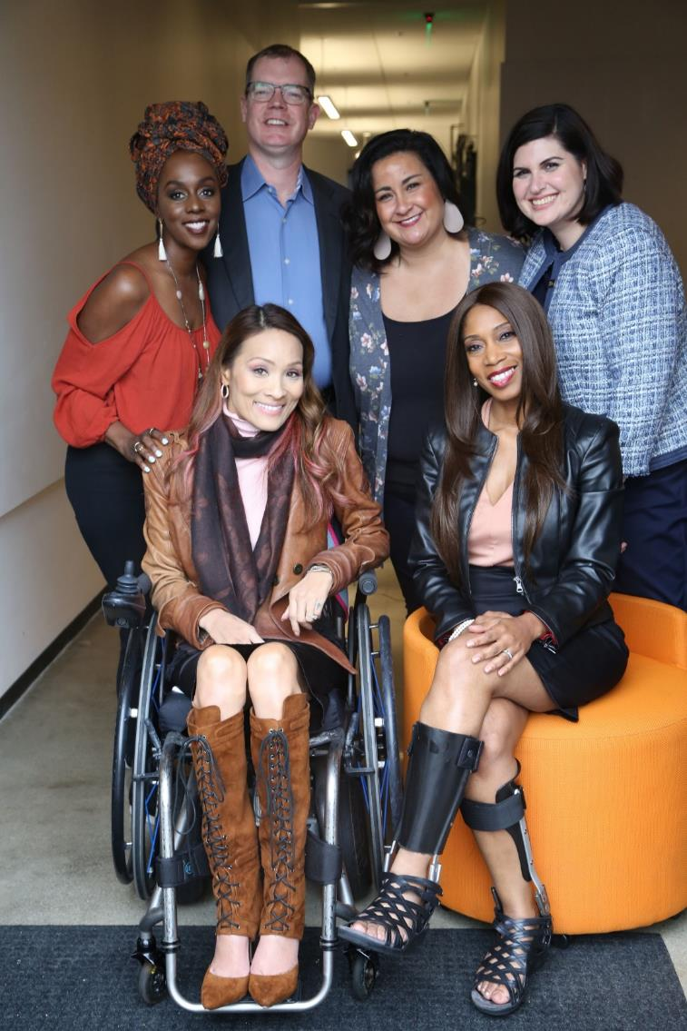
Anyone can join the disability community at any point.
The disability community can be cutting edge and innovative.
People with disabilities are diverse and part of all communities.

Slide 6
Combatting COVID-19 and Economic Crisis
STOP THE SPREAD: Leaders at every level need to advocate for and implement measures that will prevent the spread of the virus, including access to testing for people with disabilities.
PROTECT FRONTLINE RESPONDERS: Ensure front line responders and caregivers get the protection, testing and resources they need to serve those most at risk of experiencing COVID-19.
ENABLE PEOPLE WITH DISABILITIES WHO ARE LIVING IN THE COMMUNITY TO HAVE ACCESS TO FOOD & SUPPORTS. Clear guidance and protocols are needed among the caregiver and patient community to actively minimize COVID-19 transmission. This needs to include in-home protocols to care for people with disabilities who develop COVID-19, and require their standard care, but are not sufficiently ill to require a hospital bed. Expand food security measures to people who are especially at risk from the virus and/or whose disabilities limit their ability to access food at this time, including alternative delivery options if normal delivery is suspended.

Slide 7
Combatting COVID-19 and Economic Crisis (cont.)
ENSURE PEOPLE WITH DISABILITEIS CAN KEEP THEIR JOBS AND/OR GAIN EMPLOYMENT WHEN THE CRISIS IS OVER. Ensure the unemployment resources/stimulus efforts explicitly provide additional resources for people with disabilities who may lose their job as a result of lockdowns, social distancing or other pandemic-caused economic disruptions.
ENSURE ACCESSIBILITY & TRANSPORTATION: Ensure that resources and information about the spread of this virus are accessible to people who are deaf, blind and/or have cognitive disabilities. In addition, there must be options for people who have the virus and have physical disabilities to be transported to hospitals and testing sites.
OFFER ONLINE MENTAL HEALTH SUPPORTS: Pay special attention to the effect of social distancing on people with disabilities as well as the mental health consequences of social distancing and teleworking.

Slide 8
2020 Poll Data – Methodology
Methodology: A phone poll of 1,000 registered voters in a 16-state presidential and Senate battleground was conducted by phone March 9-16, 2020 from a voter-file sample. 67% of respondents were reached on cell phones in order to accurately reflect the American electorate.
Total 16-state presidential and Senate battleground: Arizona, Colorado, Florida, Georgia, Iowa, Nevada, New Hampshire, New Mexico, North Carolina, Maine, Michigan, Minnesota, Ohio, Pennsylvania, Virginia, Wisconsin
8 Diverse States = AZ (+5*), CO^ (+1^), FL (+2*), GA (+5*), NV (+1^), NM (+3^), NC (+3*), VA (+1^)
8 Non-Diverse States = IA (+3*), MI (+1^), ME (+3^), MN (+1^), NH (-), OH (+3*), PA (-), WI (-)
4 Regions:
Northeast (ME, NH, PA)
Midwest (IA, MI, MN, OH, WI)
South (FL, GA, NC, VA)
West (AZ, CO, NM, NV)
*=Republican PVI advantage ^=Democratic PVI advantage -=even

Slide 9
2020 Poll Data – Definition of the Disability Community
The disability community includes people who self-identify as having a disability, having a family member with a disability, or having a close friend with a disability.
Full questionnaire, topline and crosstabs here:
https://www.respectability.org/2020/03/new-data-voters-disabilities-2020/

Slide 10
2020 Poll Data – Key Findings
More than half of the electorate in the battleground (59%) self-identifies as having a disability (16%), having a family member with a disability (32%) or having a close friend with a disability (11%).
These voters lean more Democratic than voters outside of the disability community, but they are still politically contested at the presidential, Senate and Congressional level.
The top issues for these voters are health care and the economy, and the disability community focuses more on Social Security and Medicare and prescription drug prices than voters overall.
Both voters overall and voters within this disability community strongly believe campaigns should be accessible to people with disabilities.
Both voters overall and voters within this disability community believe more needs to be done to help people with disabilities gain skills/education and integrate into the workforce.

Slide 11
Disability Community represents more than half (59%) of the 2020 battleground
A disability can be a physical, cognitive, sensory, mental health, chronic pain or another condition that is a barrier to everyday living. Do you, a family member, or a close friend have a disability? Please check off all that apply.
Notes:
Before this slide. (CA: slide above added)
Need a presidential with 3 races for all voters.
With margins
And with the 2016 – trump and hillary graph and margin – that should come first to the left.
Also, add to that slide – the % voting in Democratic and Republican primaries (CA: done above)
Headline
Democrats and Republicans equally consolidated, with independents tilt to Democrats (CA: done)
Is this 3-1-3 - Should be if possible (CA: independents need to be 2-3-2—we only have 58 3-1-3 independents)

Slide 12
Disability Community leans Democratic in presidential race with Biden as candidate, but contested with Sanders as candidate
2020 PRESIDENTIAL BALLOT
BATTLEGROUND
+4
+5
Notes:
Before this slide. (CA: slide above added)
Need a presidential with 3 races for all voters.
With margins
And with the 2016 – trump and hillary graph and margin – that should come first to the left.
Also, add to that slide – the % voting in Democratic and Republican primaries (CA: done above)
Headline
Democrats and Republicans equally consolidated, with independents tilt to Democrats (CA: done)
Is this 3-1-3 - Should be if possible (CA: independents need to be 2-3-2—we only have 58 3-1-3 independents)

Slide 13
Disability Community most contested in Senate races; less in House races
SENATE AND CONGRESSIONAL BALLOTS
BATTLEGROUND
+2
+3
Notes:
Before this slide. (CA: slide above added)
Need a presidential with 3 races for all voters.
With margins
And with the 2016 – trump and hillary graph and margin – that should come first to the left.
Also, add to that slide – the % voting in Democratic and Republican primaries (CA: done above)
Headline
Democrats and Republicans equally consolidated, with independents tilt to Democrats (CA: done)
Is this 3-1-3 - Should be if possible (CA: independents need to be 2-3-2—we only have 58 3-1-3 independents)

Slide 14
Voters are broadly positive toward Medicaid, particularly within the Disability Community
Now, I'd like you to rate your feelings toward some people, organizations, and ideas, with one hundred meaning a VERY WARM, FAVORABLE feeling; zero meaning a VERY COLD, UNFAVORABLE feeling.
Notes:
Before this slide. (CA: slide above added)
Need a presidential with 3 races for all voters.
With margins
And with the 2016 – trump and hillary graph and margin – that should come first to the left.
Also, add to that slide – the % voting in Democratic and Republican primaries (CA: done above)
Headline
Democrats and Republicans equally consolidated, with independents tilt to Democrats (CA: done)
Is this 3-1-3 - Should be if possible (CA: independents need to be 2-3-2—we only have 58 3-1-3 independents)

Slide 15
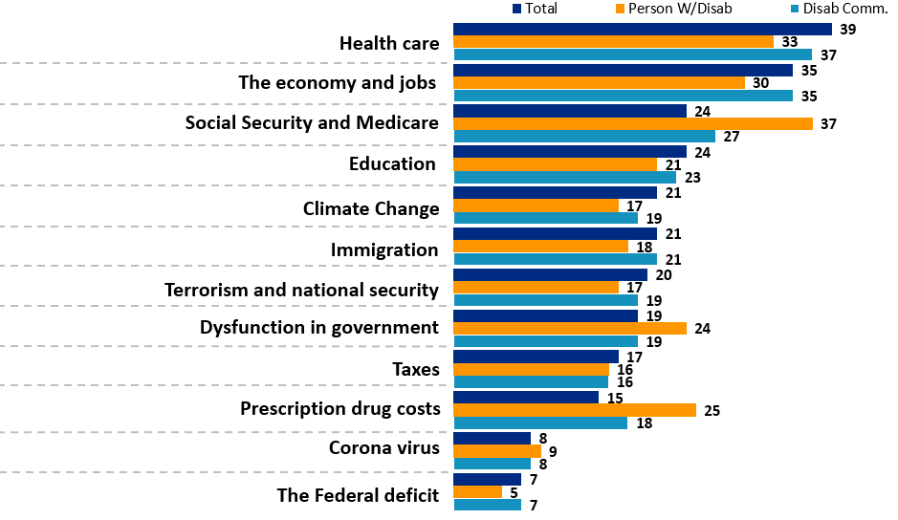
Social Security/Medicare and drug costs particularly important to Disability Community
Now thinking about the 2020 election. As you think about elections coming up in November 2020, which two or three of the following issues are the most important as you decide whom to support?
Notes:
Before this slide. (CA: slide above added)
Need a presidential with 3 races for all voters.
With margins
And with the 2016 – trump and hillary graph and margin – that should come first to the left.
Also, add to that slide – the % voting in Democratic and Republican primaries (CA: done above)
Headline
Democrats and Republicans equally consolidated, with independents tilt to Democrats (CA: done)
Is this 3-1-3 - Should be if possible (CA: independents need to be 2-3-2—we only have 58 3-1-3 independents)

Slide 16
Voters broadly agree that campaigns should be accessible, including those outside of the Disability Community
As you think about whom to support for President, how important is it to you that the candidates have campaign events and websites that are open and accessible to people with disabilities, just like everyone else?
Notes:
Before this slide. (CA: slide above added)
Need a presidential with 3 races for all voters.
With margins
And with the 2016 – trump and hillary graph and margin – that should come first to the left.
Also, add to that slide – the % voting in Democratic and Republican primaries (CA: done above)
Headline
Democrats and Republicans equally consolidated, with independents tilt to Democrats (CA: done)
Is this 3-1-3 - Should be if possible (CA: independents need to be 2-3-2—we only have 58 3-1-3 independents)

Slide 17
Focus on priorities of Disability Community electorally rewarding
Please read through the list below of things our leaders can do to address the challenges facing people with disabilities. For each, please indicate whether this stand would make you much more likely, somewhat more, a little more or no more likely to support a candidate for elected office who makes this a priority.
Ensuring that children with disabilities get the education and training they need to succeed. | Total | Person w/Disab. | Disab Comm. | Friend of Disab. Person
Much more likely | 59 | 63 | 60 | 61
Somewhat more likely | 28 | 27 | 27 | 24
A little more likely | 7 | 5 | 7 | 11
No more likely | 5 | 3 | 5 | 4
Not sure | 2 | 2 | 2 | 1
Much/Somewhat more | 87 | 90 | 87 | 85
A little/No more | 12 | 8 | 12 | 15
Expanding job and career opportunities for people with disabilities, so they can succeed just like anyone else. | Total | Person w/Disab. | Disab Comm. | Friend of Disab. Person
Much more likely | 51 | 59 | 54 | 47
Somewhat more likely | 33 | 31 | 30 | 35
A little more likely | 9 | 5 | 8 | 13
No more likely | 6 | 5 | 7 | 5
Not sure | 1 | 1 | 1 | 0
Much/Somewhat more | 84 | 90 | 84 | 82
A little/No more | 15 | 10 | 15 | 18
Notes:
Before this slide. (CA: slide above added)
Need a presidential with 3 races for all voters.
With margins
And with the 2016 – trump and hillary graph and margin – that should come first to the left.
Also, add to that slide – the % voting in Democratic and Republican primaries (CA: done above)
Headline
Democrats and Republicans equally consolidated, with independents tilt to Democrats (CA: done)
Is this 3-1-3 - Should be if possible (CA: independents need to be 2-3-2—we only have 58 3-1-3 independents)

Slide 18
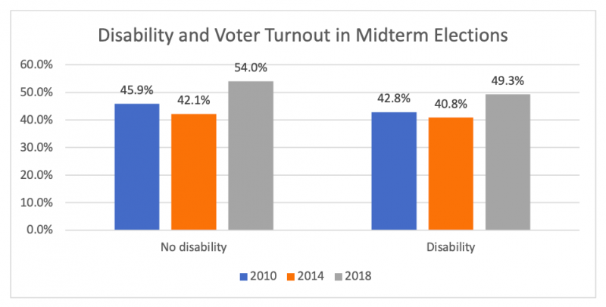
Turnout Among Voters with Disabilities in 2018…
An estimated 14.3 million people with disabilities voted, surpassing the number of Hispanic/Latino voters (11.7 million) and nearing the number of African-American voters (15.2 million).
10.2 million voters live with someone who has a disability. Added to the 14.3 million voters with disabilities, that’s a total of 24.5 million voters in “disability households” – equal to 20 percent of all voters in the 2018 midterms.
Source: https://smlr.rutgers.edu/news/voter-turnout-surges-among-people-disabilities

Slide 19
8 Steps to Connect with Voters with Disabilities
Build connections.
Be inclusive – Nothing Without Us.
Put out a statement.
Learn and use respectful language.
Make your social media and website accessible.
Make all events and materials ADA accessible.
Make sure people know your events are accessible.
Consider intersectionality.

Slide 20
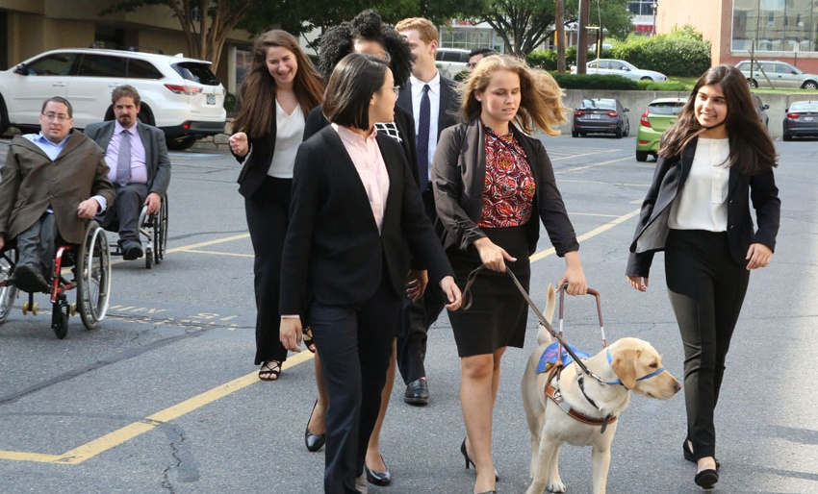
1. Build Connections
America has 56 million people with disabilities, more than 20 million of whom are working age. Polls show the majority of voters either have a disability or a loved one with a disability.
63% of Americans are part of the extended disability community.
Include us in all policies that impact our lives. We are ready to be your partners in success.

Slide 21
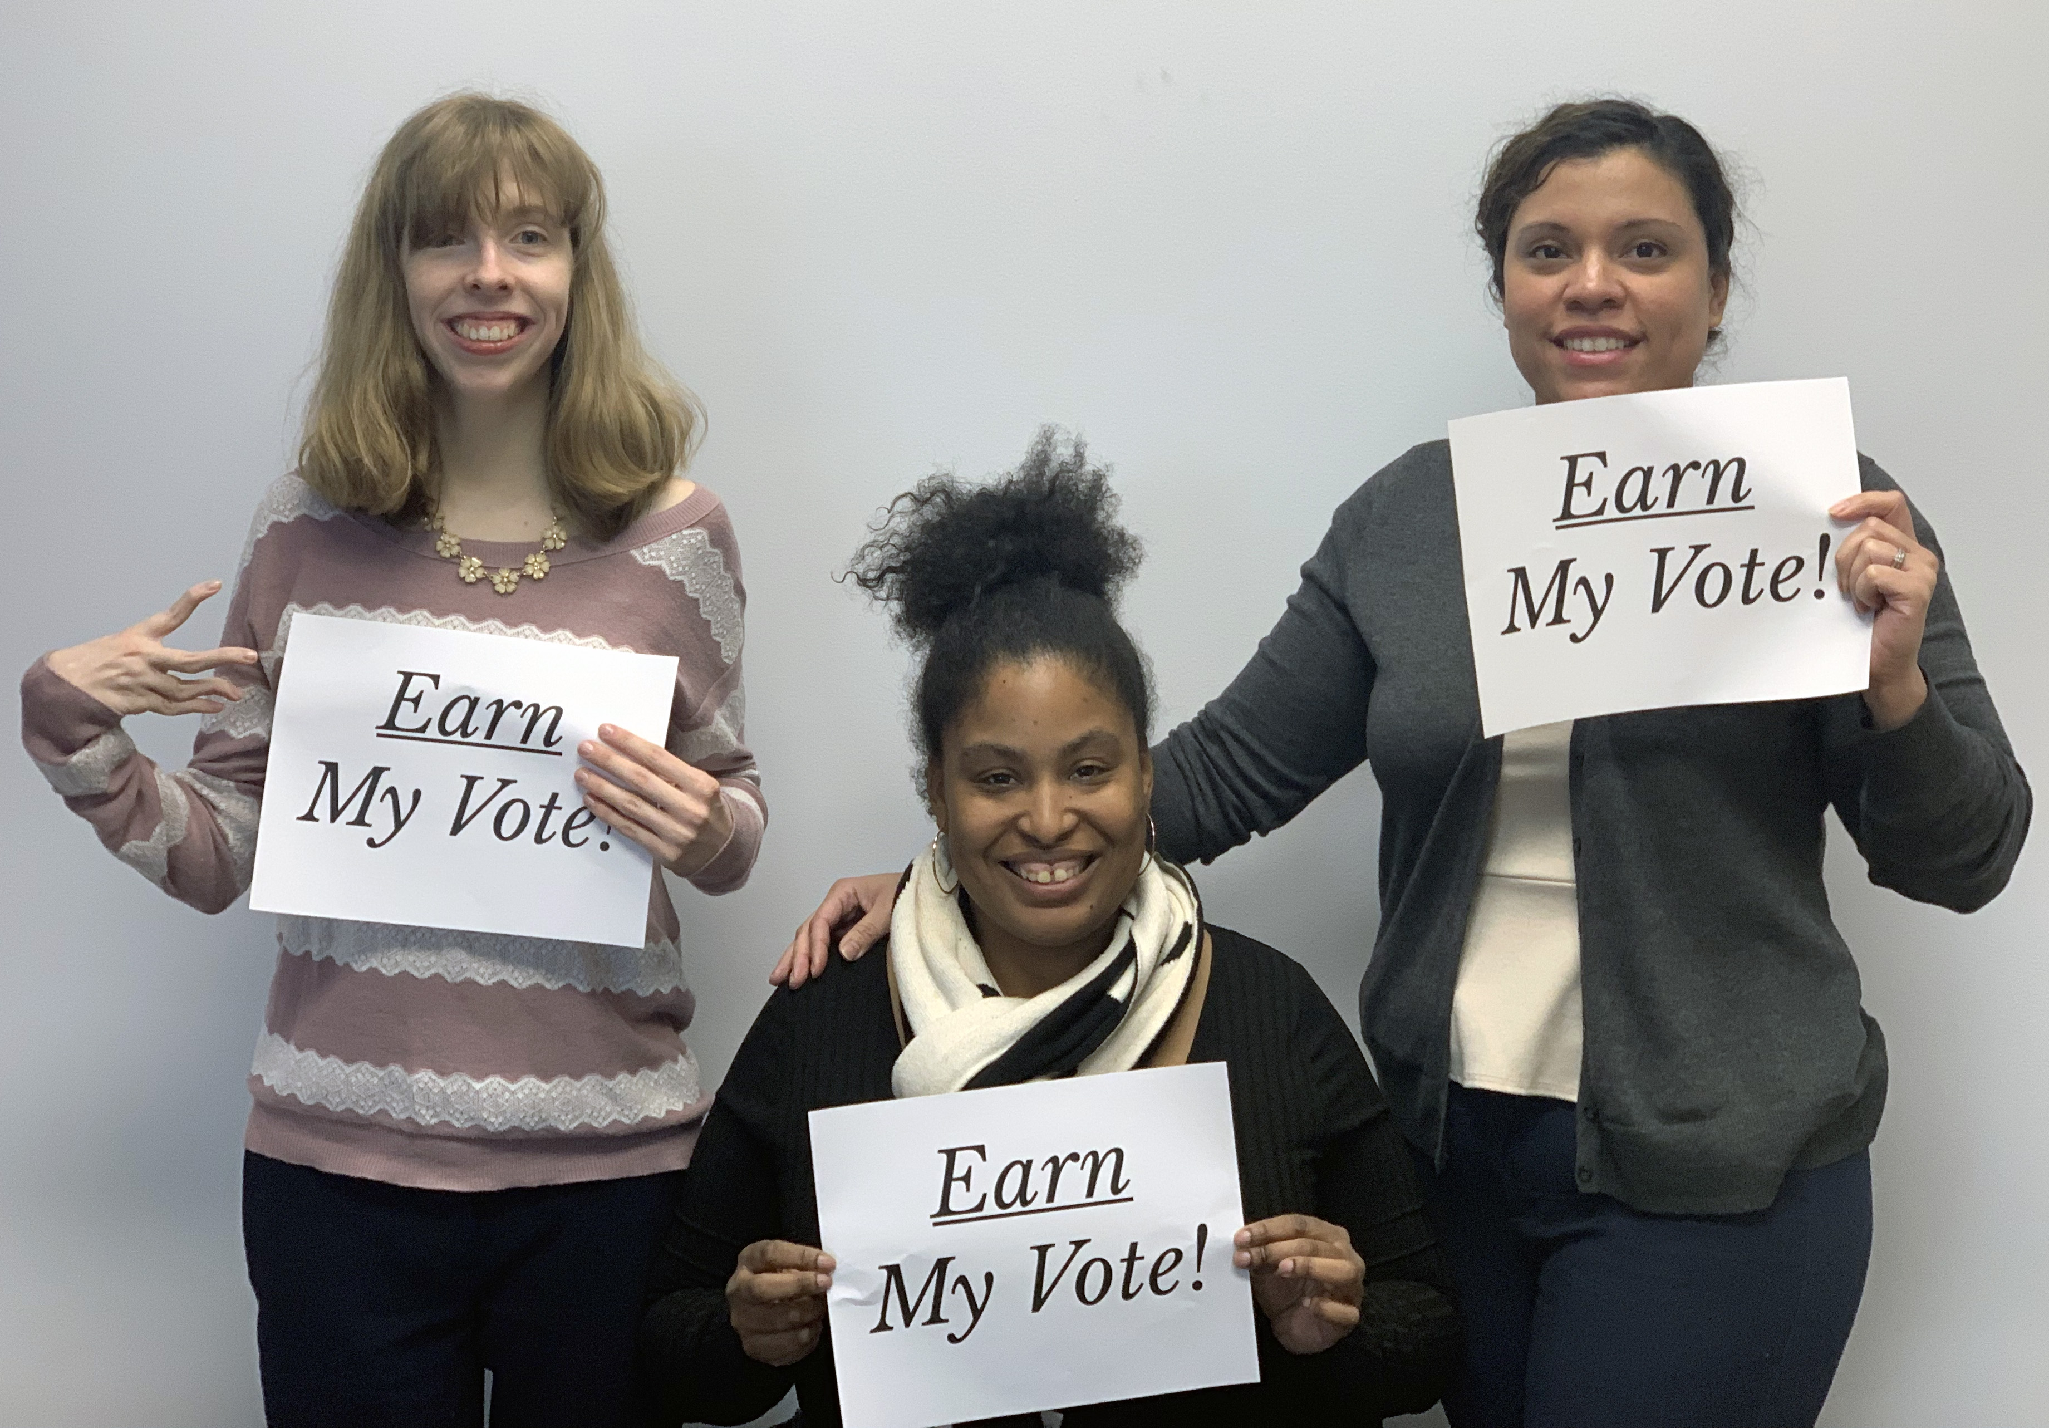
2. Be Inclusive – Nothing Without Us
Most important: Treat any person with a disability with the same respect and high expectations you would treat any other person.
Make sure that constituents are aware you are willing to make accommodations so they can participate, just like anyone else.
Schedule events and job interviews at an accessible location. Keep transportation in mind.
Use vendors who are or who hire people with disabilities.
Learn more about etiquette on interacting with people with disabilities: www.respectability.org/inclusion-toolkits/etiquette-interacting-with-peoplewith-disabilities.

Slide 22
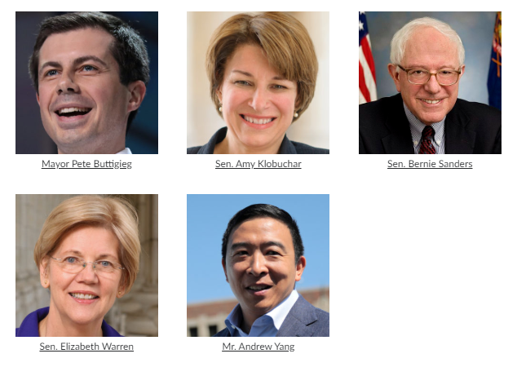
3. Put Out a Statement on www.VoteAbility.com
Talk about how you will create new job opportunities for people with disabilities. Yes, a safety net is very important. However, studies show that most people with disabilities can and want to work.
Many organizations have concrete policy recommendations on how to lead on this issue.
Several candidates responded to RespectAbility’s 2020 Disability Voter Candidate Questionnaire.

Slide 23
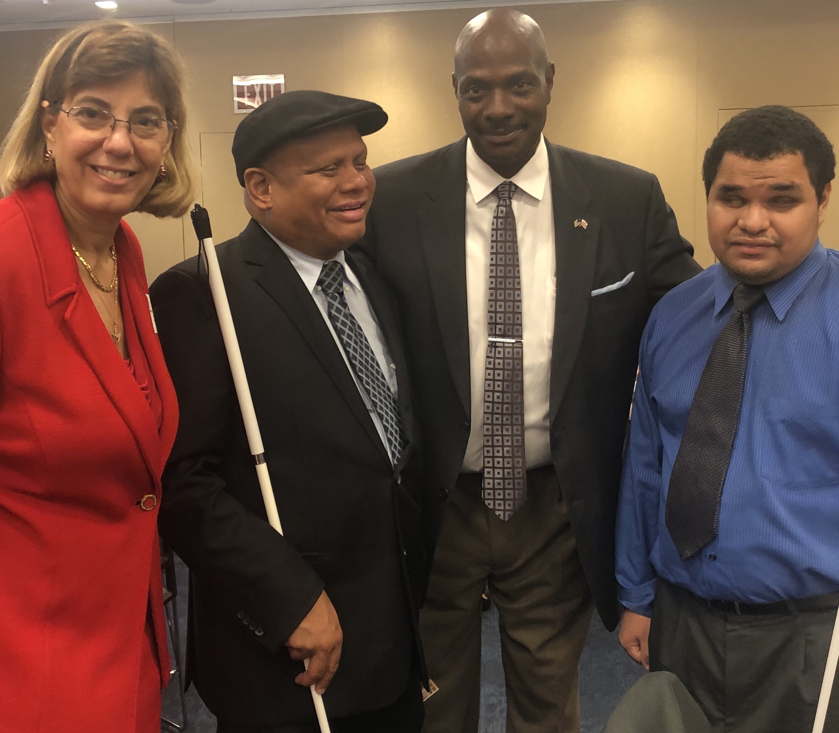
4. Learn and Use Respectful Language
Person-first language vs. Identity-first language – ask the person how they want to be identified.
Think about other language you use. Instead of describing someone as “wheelchair bound,” describe him as a “person who uses a wheelchair.” Don’t use words like “stupid” or “retarded” to mean incompetent.
There are many resources on appropriate communication that can be helpful to you and your staff: www.respectability.org/inclusion-toolkits/terminology-tips-using-the-appropriate-lexicon.
Webinar on Ensuring a Welcoming Lexicon: https://vimeo.com/379886686

Slide 24
5. Social Media and Website Accessibility
Video hosting sites such as YouTube have free tools that allow users to add automated subtitles to their clips, but they are not perfect. It is important to ensure the accuracy of the captions.
Making a transcript of the video available online is also an incredibly helpful resource for users who have auditory disabilities, like Deafness or Hard of Hearing.
Add textual descriptions, or “alternative text,” to charts, graphs, images and maps so that they are discernible by assistive technology. Additionally, ensure that images on your social media (Facebook/Twitter/Instagram/etc.) are described in this manner.
Add audio description for materials presented visually.
Ensure your website includes a site index.
Many of these things also increase your Search Engine Optimization, increasing your reach.
Watch RespectAbility’s webinar on web accessibility: https://vimeo.com/386336396.

Slide 25
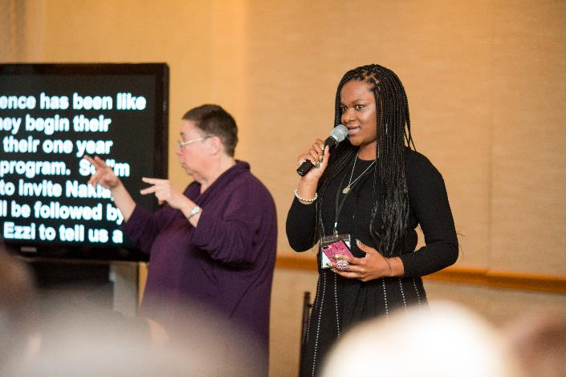
6. Accessible Events and Materials
Ensure your events are held in accessible locations and accommodations (i.e., ASL interpreters) are provided when requested. Sample partial event checklist:
Invitation/Notification of Event
Does the invitation clearly indicate that people with all abilities are welcome?
Do appropriate icons appear (e.g., physical access, sign language interpreter available)?
Is the writing clear, in an easily legible font and size?
Do visual images depict inclusion of people with disabilities?
Have you included a contact name and number for accommodations inquiries?
Facilities
Is the facility accessible – for wheelchairs, walkers and scooters? If the event is standing-room only, is there a section for wheelchair users and those who need to sit?
Communication
Will there be a sign language interpreter? Live captioning (CART)?
If there are videos, will there be subtitles?

Slide 26
6. Accessible Events and Materials (cont.)
Staff/Volunteers
Have you arranged for volunteers?
Have they received orientation/sensitization and training to respond to inquiries?
At an event, provide handouts in an electronic version during meetings and presentations for individuals who need or want to use technology to access and manipulate the materials. Provide individuals with transcripts for purely audio files that do not have a visual component.
Resources:
https://accessibility.cornell.edu/event-planning/accessible-meeting-and-event-checklist/
https://hr.cornell.edu/sites/default/files/documents/accessible_meeting_checklist.pdf
https://splashthat.com/blog/accessible-event-planning
Webinar on Ensuring Accessible Events: https://vimeo.com/375927062.

Slide 27
7. Let People Know Your Events Are Accessible
Planning on having access and space for wheelchairs, captioned and audio described videos, sign-language interpreters and communication access real-time translation (CART)? Share this information in your event announcement!
In your event RSVP form, ask participants if they need an accommodation.
All large events should automatically be accessible for wheelchair users, have captions and sign language interpreters.
Sample inclusion language to use for accommodations:
Accommodation requests should be directed to (Name) at 222-222-222 no later than (deadline if appropriate).
Additional language may be added to state that requests for accommodations made after the advertised date will be honored to the maximum extent feasible.

Slide 28
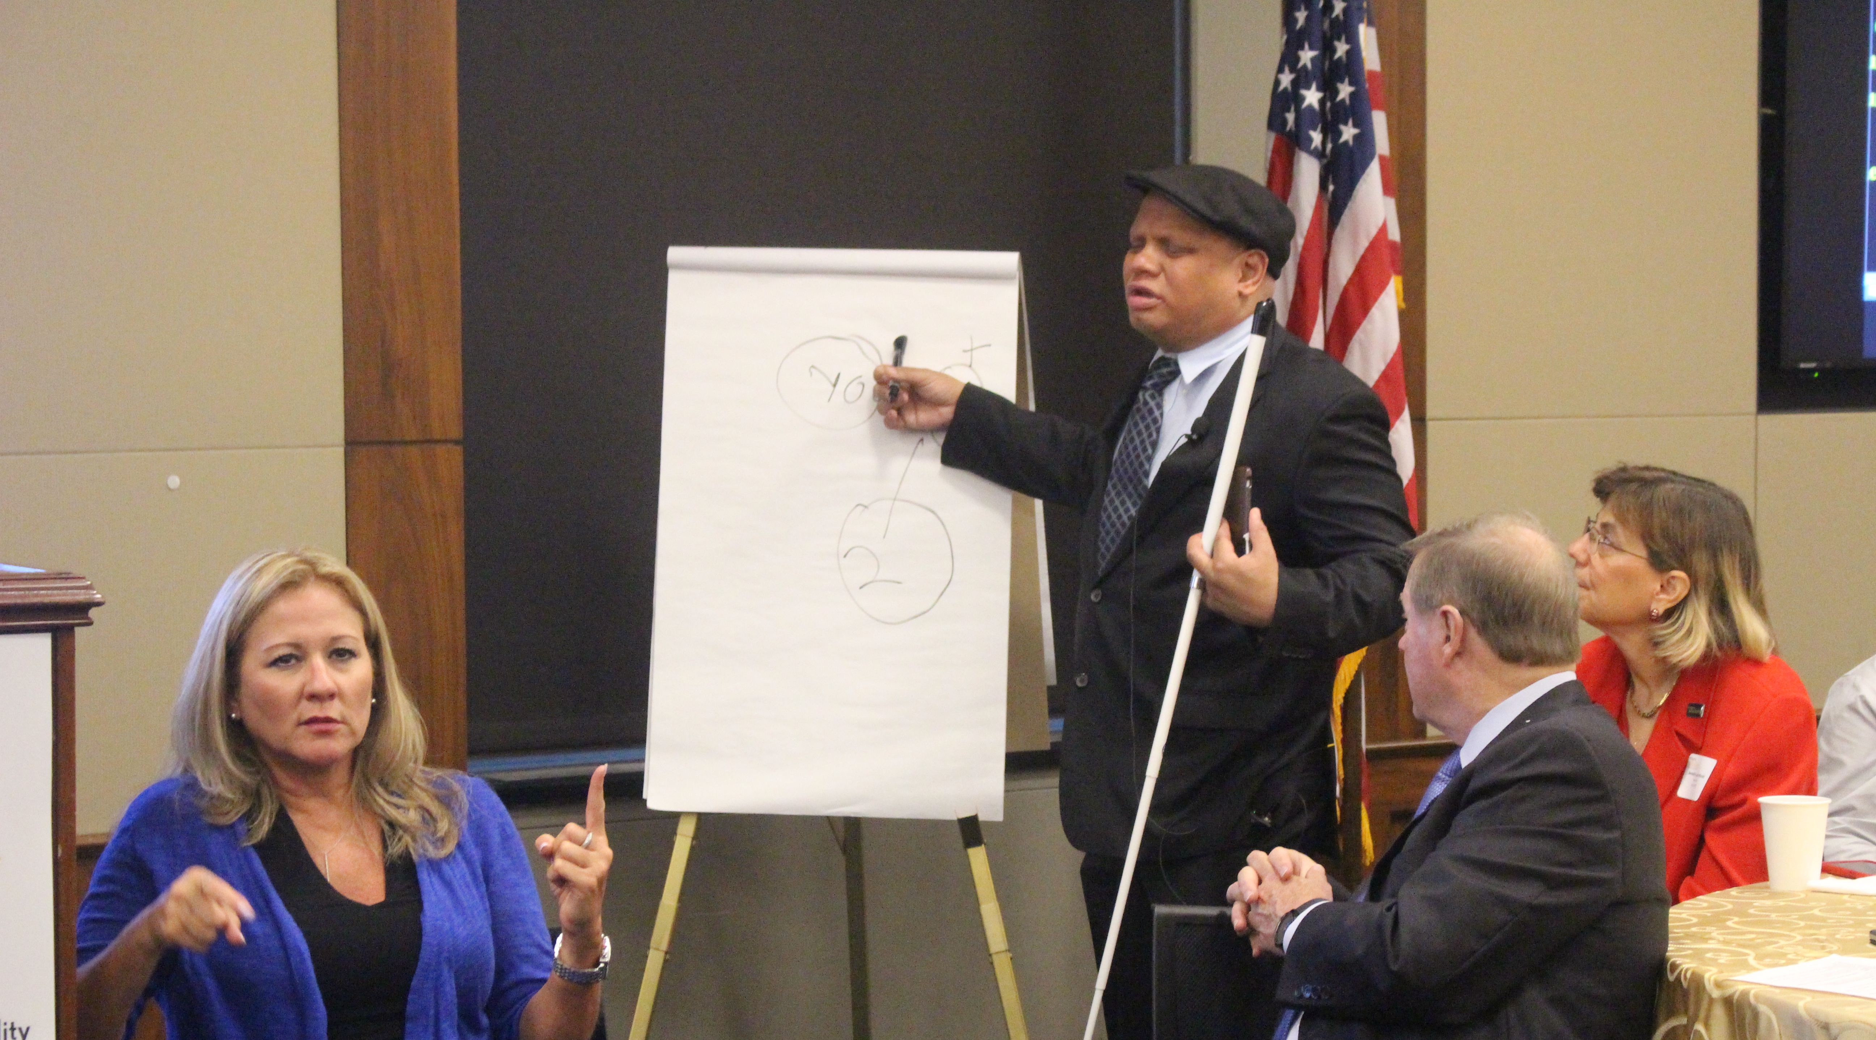
8. Focus on Intersectionality
Intersectionality describes multiple threats of discrimination when an individual’s identities overlap with a number of minority classes, such as race, gender, age, ethnicity, disability and other characteristics. Kimberlé Williams Crenshaw coined the term in her 1989 essay.
People of color and English as Second Language Learners with disabilities have unique barriers and are less likely to receive the disability diagnosis and early intervention they need.
People who live with multiple minority status are more at risk for school suspensions, dropping out of school, homelessness, addiction, incarceration, abuse and other issues.
Issues such as immigration, the school-to-prison pipeline, trafficking and foster care all have both race and disability angles.
Ensure that people with disabilities are on panels and programs, especially those on education, poverty, healthcare, employment and social justice.

Slide 29
Equity and Access Webinar Series
Disability 101
Disability History
How to Ensure Accessible Events
How to Recruit, Accommodate and Promote People with Disabilities for Volunteer Leadership, Board Positions and Paid Employment
How to Ensure A Welcoming Lexicon and Inclusive Storytelling
How to Ensue Accessible Websites and Social Media
Premium Skills Workshop in Social Media Accessibility
How to Ensure Legal Rights and Compliance Obligations: Exploring the Rights of Employees and Participants, and the Obligations of Nonprofit Organizations Under the Law
Available Online Via Video and Transcript: https://www.respectability.org/accessibility-webinars

Slide 30
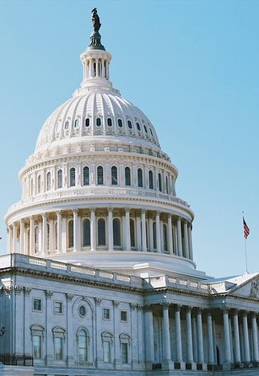
Previous Data – 2018 Midterms and People with Disabilities
2018 poll of 1000 likely voters.
34% Swing Voters, 36% Democrats, 29% Republicans.
The Disability Community is More Politically Engaged:
More than half of Americans with disabilities have reached out to their elected officials or attended a political rally in the recent past versus 39% of Americans without a disability or any disability connection.

Slide 31
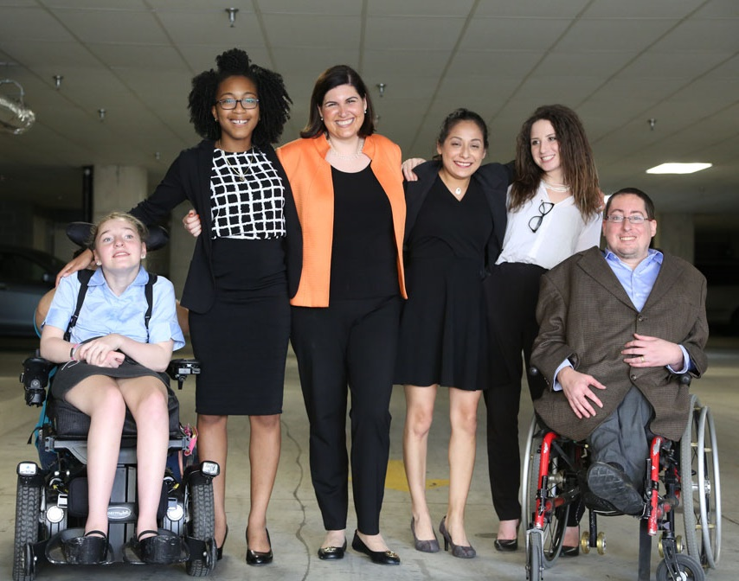
Previous Data – 2018 Midterms and PWDs (cont.)
35% of people with disabilities evaluated 2018 as America having a “Bad Year.”
Another 24% thought it was “only fair.”
86% of Americans with disabilities wanted Congress to pursue change in 2019.
49% wanted “significant, bold change.”

Slide 32
2018 and 2016 Polling Data
Disability Community Determined to Voice Opinions in 2018 National Survey – Key Findings:
54% of voters are in the disability community.
58% of disability community say country is on the wrong track.
Election 2016 Polling Results from Two Separate Bipartisan Polls : December 2016 (GQRR, Lake Research Partners, and North Star) – Key Findings:
In November poll, voters with disabilities were around even between Trump and Clinton (46% vs. 48%).
84% of voters are more likely to support a candidate who prioritizes “expanding job opportunities for people with disabilities, so they can succeed just like anyone else.”

Slide 33
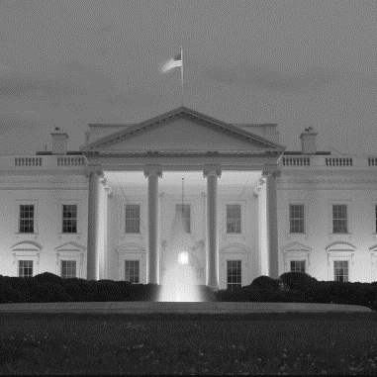
November 2016 Poll: People with disabilities were as divided on the election as those without disabilities.
2016 Presidential Popular Vote
Presidential Vote

Slide 34
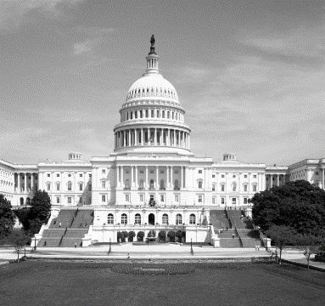
However, in the Congressional vote, people with disabilities were much more likely to vote Democrat for Congress.
Congressional Vote
Congressional Vote

Slide 35
Thank you!
RespectAbility
JenniferM@RespectAbility.org
www.RespectAbility.org
Greenberg Research
(202) 499-6901
www.greenbergresearch.com

